Slide 1
Probabilistic Programming
Marius Popescu
popescunmarius@gmail.com
2018 - 2019

Slide 2
Bayesian Hypothesis Testing

Slide 3
Hypothesis Testing
One of the most frequently encountered scientific procedures is a comparison of two groups. Given data from two groups, researchers ask various comparative questions: How much is one group different from another? Can we be reasonably sure that the difference is non-zero? How certain are we about the magnitude of difference? These questions are difficult to answer because data are contaminated by random variability.

Slide 4
Hypothesis Testing
Part of a data scientist’s goal is to be a champion of experiments, and one of the best tools for a data scientist is a well-designed split-test experiment.
Hypothesis testing is a statistical design pattern for determining the difference of effectiveness between two different treatments:
A pharmaceutical company is interested in the effectiveness of drug A vs drug B. The company will test drug A on some fraction of their trials, and drug B on the other fraction. After performing enough trials, the in-house statisticians sift through the data to determine which drug yielded better results.
Front-end web developers are interested in which design of their website yields more sales or some other metric of interest. They will route some fraction of visitors to site A, and the other fraction to site B, and record if the visit yielded a sale or not. The data is recorded (in real-time), and analyzed afterwards.

Slide 5

Hypothesis Testing in Machine Learning
Comparing the performance of different machine learning methods on a given problem is another matter that is not so easy as it sounds: to be sure that apparent differences are not caused by chance effects, statistical tests are needed.
…
How can we be confident about whether the difference in measurement for two or more algorithms denotes a statistically significant difference in their performance? Is this statistical difference practically relevant as well? How can we best use the available data to discover whether such differences exist?

Slide 6
Bayesian Hypothesis Testing in Machine Learning
The machine learning community adopted the use of null hypothesis significance testing (NHST) in order to ensure the statistical validity of results. Many scientific fields however realized the shortcomings of frequentist reasoning and in the most radical cases even banned its use in publications. We should do the same: just as we have embraced the Bayesian paradigm in the development of new machine learning methods, so we should also use it in the analysis of our own results.
Benavoli, A., Corani, G., Demšar, J., & Zaffalon, M. (2017). Time for a change: a tutorial for comparing multiple classifiers through Bayesian analysis. The Journal of Machine Learning Research, 18(1), 2653-2688.

Slide 7
Bayesian A/B Testing

Slide 8
Bayesian A/B Testing
The fundamental idea in an A/B test is that we consider a perfect counterfactual universe, where the population under study is identical but subject to some treatment, then any differences between the populations after the study must be attributed to the treatment. In practice, we can’t spin up other universes, so we rely on using large enough samples in two groups that approximate a counterfactual.

Slide 9
Conversion Testing
We have two Web site designs, called A and B. When a user lands on our Web site, we randomly show them design A or B, and record this assignment. After enough visitors have done this, we join this dataset against some metric of interest (typically, for Web sites, we are interested in a purchase or signup, call it conversion). For example, consider the following numbers:
visitors_to_A = 1300
visitors_to_B = 1275
conversions_from_A = 120
conversions_from_B = 125
What we are really interested in is the probability of conversion, given site A or B. As a business, we want this probability to be as high possible. So our goal is to determine which site, A or B, has a high probability of conversion.

Slide 10
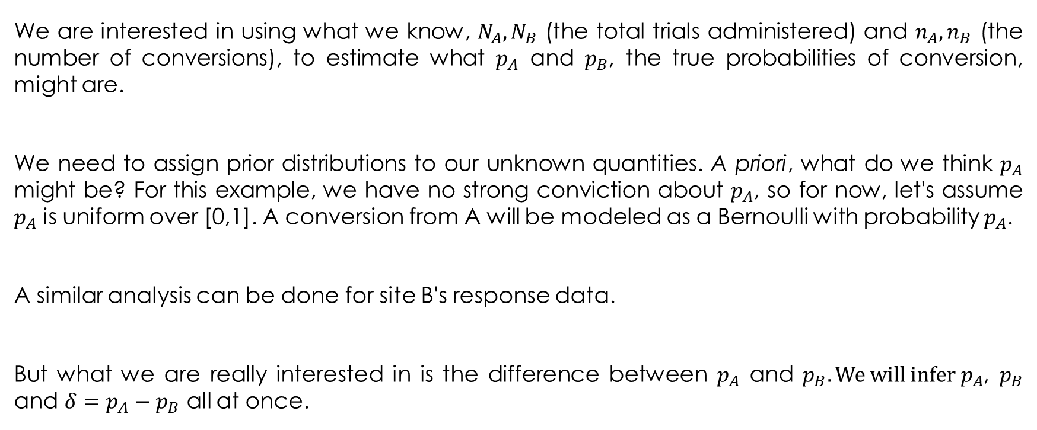
A First Bayesian Model
We are interested in using what we know, $N_{A}, N_{B}$ (the total trials administered) and $n_{A}, n_{B}$ (the number of conversions), to estimate what $p_{A}$ and $p_{B}$, the true probabilities of conversion, might are.
We need to assign prior distributions to our unknown quantities. A priori, what do we think $p_{A}$ might be? For this example, we have no strong conviction about $p_{A}$, so for now, let's assume $p_{A}$ is uniform over [0,1]. A conversion from A will be modeled as a Bernoulli with probability $p_{A}$.
A similar analysis can be done for site B's response data.
But what we are really interested in is the difference between $p_{A}$ and $p_{B}. We will infer{ p}_{A}$, $p_{B}$ and $δ=p_{A}−p_{B}$ all at once.

Slide 11
A First Bayesian Model
true_p_A = 0.05
true_p_B = 0.04
N_A = 1500
N_B = 750
observations_A = pm.rbernoulli(true_p_A, N_A)
observations_B = pm.rbernoulli(true_p_B, N_B)
p_A = pm.Uniform("p_A", 0, 1)
p_B = pm.Uniform("p_B", 0, 1)
@pm.deterministic
def delta(p_A=p_A, p_B=p_B):
return p_A - p_B
obs_A = pm.Bernoulli("obs_A", p_A, value=observations_A, observed=True)
obs_B = pm.Bernoulli("obs_B", p_B, value=observations_B, observed=True)
mcmc = pm.MCMC([p_A, p_B, delta, obs_A, obs_B])
mcmc.sample(20000, 1000)

Slide 12
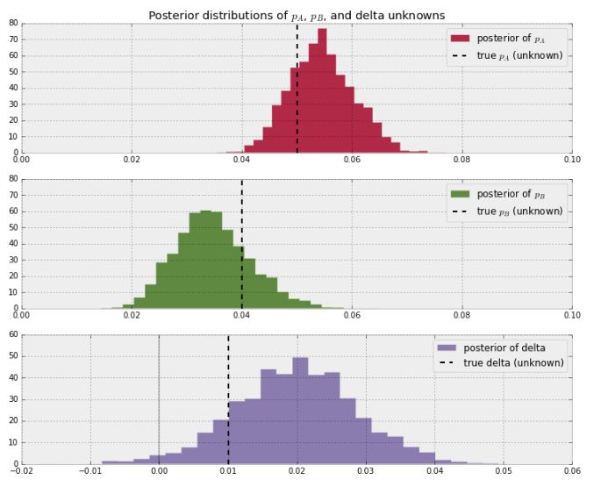
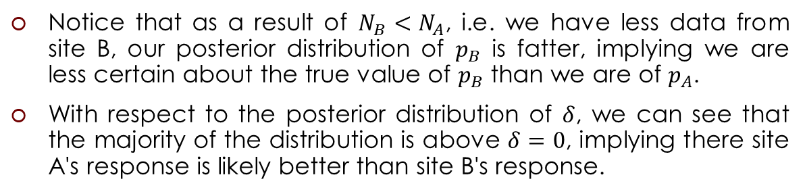
The Results
print("Probability site A is WORSE than site B: %.3f" % \
(delta_samples < 0).mean())
print("Probability site A is BETTER than site B: %.3f" % \
(delta_samples > 0).mean())
[Output]:
Probability site A is WORSE than site B: 0.017
Probability site A is BETTER than site B: 0.983
Notice that as a result of $N_{B}<N_{A}$, i.e. we have less data from site B, our posterior distribution of $p_{B}$ is fatter, implying we are less certain about the true value of $p_{B}$ than we are of $p_{A}$.
With respect to the posterior distribution of $δ$, we can see that the majority of the distribution is above $δ=0$, implying there site A's response is likely better than site B's response.

Slide 13
Conversion Testing
We have two Web site designs, called A and B. When a user lands on our Web site, we randomly show them design A or B, and record this assignment. After enough visitors have done this, we join this dataset against some metric of interest (typically, for Web sites, we are interested in a purchase or signup, call it conversion). For example, consider the following numbers:
visitors_to_A = 1300
visitors_to_B = 1275
conversions_from_A = 120
conversions_from_B = 125
What we are really interested in is the probability of conversion, given site A or B. As a business, we want this probability to be as high possible. So our goal is to determine which site, A or B, has a high probability of conversion.

Slide 14
A Second Bayesian Model
We’ll model the probability of conversion given site A, or site B.
Since we are modeling a probability, a good choice for a prior distribution is the Beta distribution. (Why? It is restricted to values between 0 and 1, identical to the range that probabilities can take on.)
Our number of visitors and conversion data are binomial: for site A, out of 1,300 trials, we had 120 successes.
Recall that a Beta prior and binomial observations have a conjugate relationship; this means we don’t need to perform any MCMC!

Slide 15
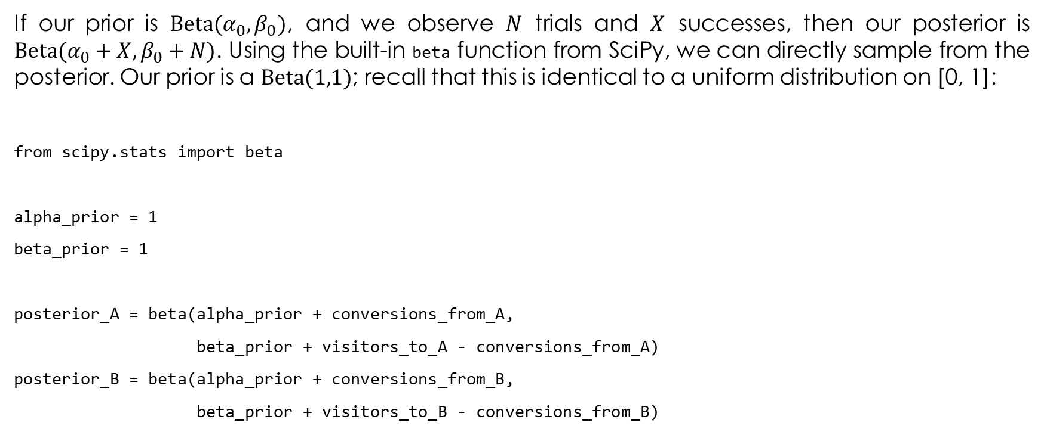
A Second Bayesian Model
If our prior is $\text{Beta}(α_{0},β_{0})$, and we observe $N$ trials and $X$ successes, then our posterior is $\text{Beta}(α_{0}+X,β_{0}+N)$. Using the built-in beta function from SciPy, we can directly sample from the posterior. Our prior is a $\text{Beta}(1,1)$; recall that this is identical to a uniform distribution on [0, 1]:
from scipy.stats import beta
alpha_prior = 1
beta_prior = 1
posterior_A = beta(alpha_prior + conversions_from_A,
beta_prior + visitors_to_A - conversions_from_A)
posterior_B = beta(alpha_prior + conversions_from_B,
beta_prior + visitors_to_B - conversions_from_B)

Slide 16
A Second Bayesian Model
Next, we’d like to determine which group has a large probability of conversion. To do this, similar to MCMC, we use samples from the posterior and compare the probability that samples from the posterior of A are larger than samples from the posterior of B. We use the rvs method to generate samples:
samples = 20000 # We want this to be large to get a better approximation.
samples_posterior_A = posterior_A.rvs(samples)
samples_posterior_B = posterior_B.rvs(samples)
print (samples_posterior_A > samples_posterior_B).mean()
[Output]:
0.31355

Slide 17
The Results
So we can see here that there is a 31% chance that site A converts better than site B. (Conversely, there is a 69% chance that site B converts better than A.) This is not very significant; consider that if we reran this experiment with identical pages, it would return a probability close to 50%.

Slide 18
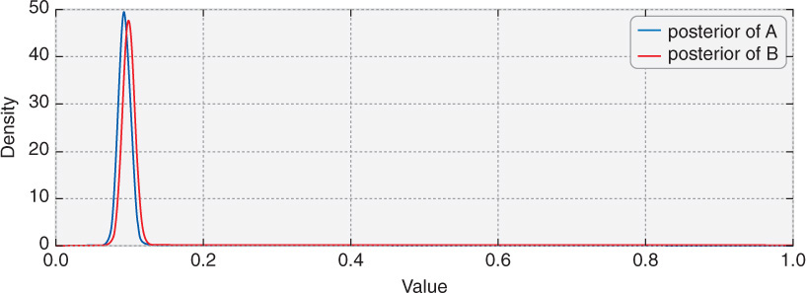
The conversion posteriors of sites A and B
We can visualize the posterior, too, without using histograms. This is done by using the pdf method:
x = np.linspace(0,1, 500)
plt.plot(x, posterior_A.pdf(x),
label='posterior of A’)
plt.plot(x, posterior_B.pdf(x),
label='posterior of B')

Slide 19
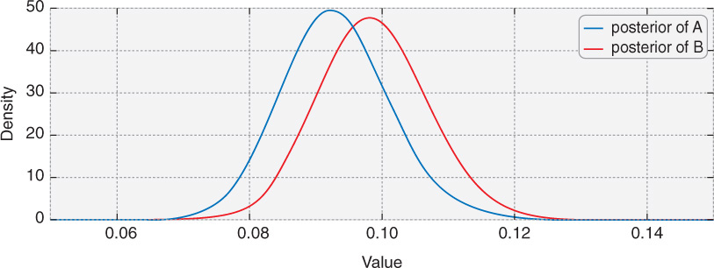
Zooming in closer to the area of interest

Slide 20
Extending A/B Testing
Adding a Linear Loss Function

Slide 21
Adding a Linear Loss Function
Our previous A/B test analysis was only concerned with whether the user signed up or not; now, we want to know what the expected revenue to be earned is.
A common goal of Internet companies is not only to gain signups, but also to optimize which signup plan the user might select. For example, a business might want new customers to choose a higher-priced plan if presented with two or more plan options.
Suppose users are shown two different versions of this pricing page, and we’d like to determine the expected revenue we receive per impression.

Slide 22
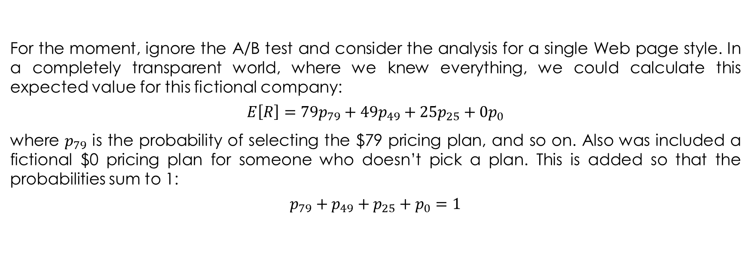
Expected Revenue Analysis
For the moment, ignore the A/B test and consider the analysis for a single Web page style. In a completely transparent world, where we knew everything, we could calculate this expected value for this fictional company:
$$E\left[R\right]=79p_{79}+{49p}_{49}+25p_{25}+0p_{0}$$
where $p_{79}$ is the probability of selecting the $79 pricing plan, and so on. Also was included a fictional $0 pricing plan for someone who doesn’t pick a plan. This is added so that the probabilities sum to 1:
$$p_{79}+p_{49}+p_{25}+p_{0}=1$$

Slide 23
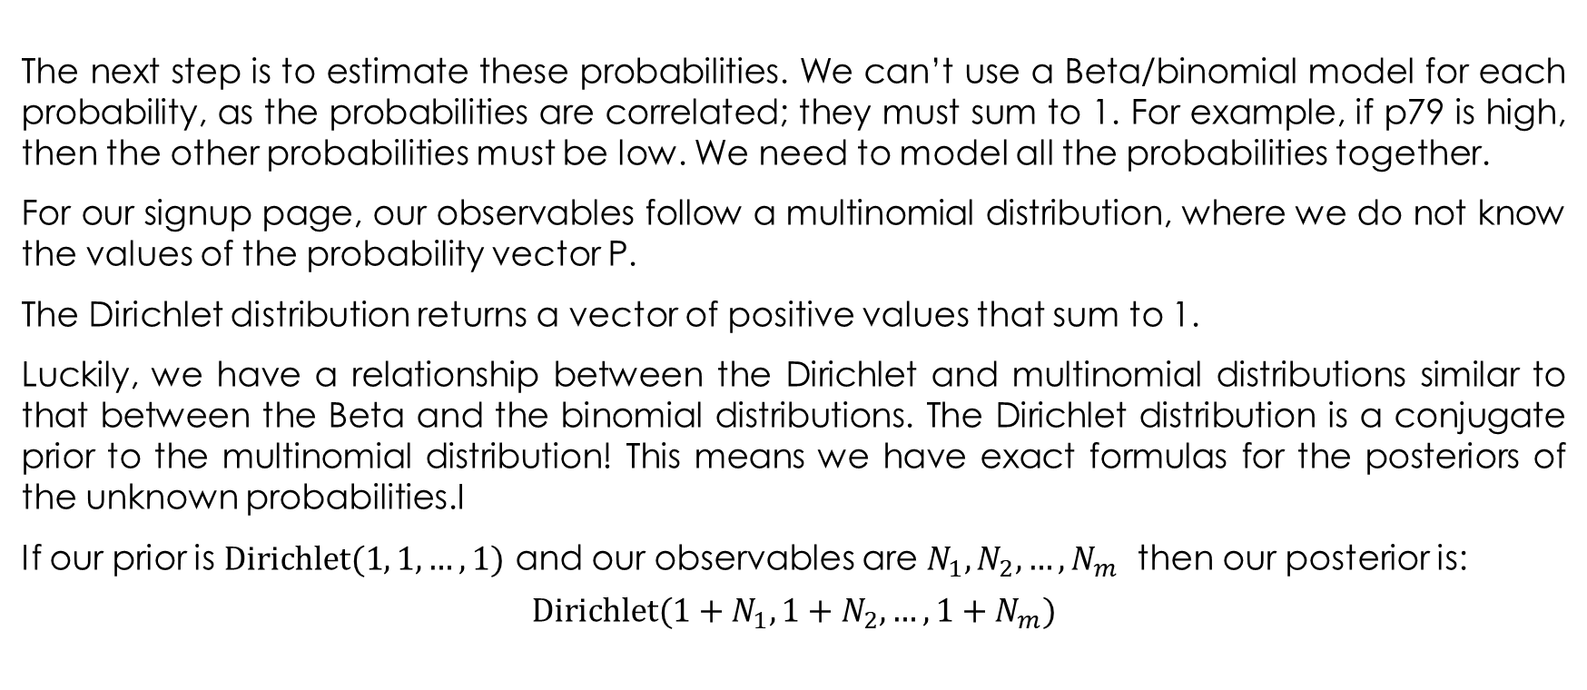
Expected Revenue Analysis
The next step is to estimate these probabilities. We can’t use a Beta/binomial model for each probability, as the probabilities are correlated; they must sum to 1. For example, if p79 is high, then the other probabilities must be low. We need to model all the probabilities together.
For our signup page, our observables follow a multinomial distribution, where we do not know the values of the probability vector P.
The Dirichlet distribution returns a vector of positive values that sum to 1.
Luckily, we have a relationship between the Dirichlet and multinomial distributions similar to that between the Beta and the binomial distributions. The Dirichlet distribution is a conjugate prior to the multinomial distribution! This means we have exact formulas for the posteriors of the unknown probabilities.I
If our prior is $\text{Dirichlet}(1, 1, …, 1)$ and our observables are $N_{1}, N_{2}, …, N_{m}$ then our posterior is:
$$\text{Dirichlet}(1+N_{1}, 1+N_{2}, …, 1+N_{m})$$

Slide 24
Expected Revenue Analysis
Suppose 1,000 people view the page, and we have the following signups:
N = 1000; N_79 = 10; N_49 = 46; N_25 = 80
N_0 = N - (N_79 + N_49 + N_49)
observations = np.array([N_79, N_49, N_25, N_0])
prior_parameters = np.array([1,1,1,1])
posterior_samples = np.random.dirichlet(prior_parameters + observations,
size=10000)
print "Two random samples from the posterior:"
print posterior_samples[0]
print posterior_samples[1]
[Output]:
Two random samples from the posterior:
[ 0.0165 0.0497 0.0638 0.8701]
[ 0.0123 0.0404 0.0694 0.878 ]

Slide 25
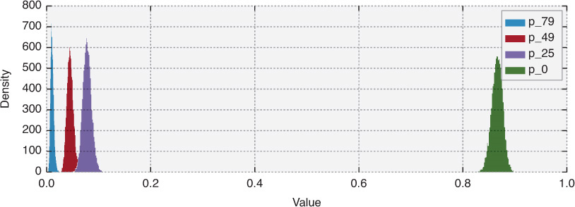
The Probability Density Function of this Posterior

Slide 26
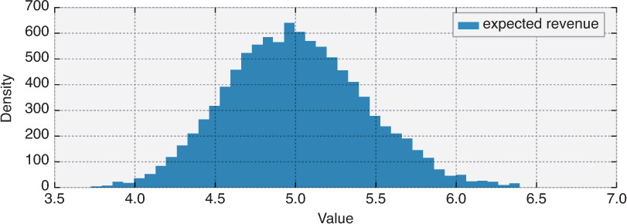
Posterior Distributions of the Expected Revenue
We can see that the expected revenue is likely between $4 and $6, and unlikely to be outside this range.

Slide 27
Extending to an A/B Experiment: Some Artificial Data
N_A = 1000
N_A_79 = 10
N_A_49 = 46
N_A_25 = 80
N_A_0 = N_A - (N_A_79 + N_A_49 + N_A_49)
observations_A = np.array([N_A_79, N_A_49, N_A_25, N_A_0])
N_B = 2000
N_B_79 = 45
N_B_49 = 84
N_B_25 = 200
N_B_0 = N_B - (N_B_79 + N_B_49 + N_B_49)
observations_B = np.array([N_B_79, N_B_49, N_B_25, N_B_0])

Slide 28
Extending to an A/B Experiment: The Model
prior_parameters = np.array([1,1,1,1])
posterior_samples_A = np.random.dirichlet(prior_parameters + observations_A, size = 10000)
posterior_samples_B = np.random.dirichlet(prior_parameters + observations_B, size = 10000)
def expected_revenue(P):
return 79*P[:,0] + 49*P[:,1] + 25*P[:,2] + 0*P[:,3]
posterior_expected_revenue_A = expected_revenue(posterior_samples_A)
posterior_expected_revenue_B = expected_revenue(posterior_samples_B)

Slide 29
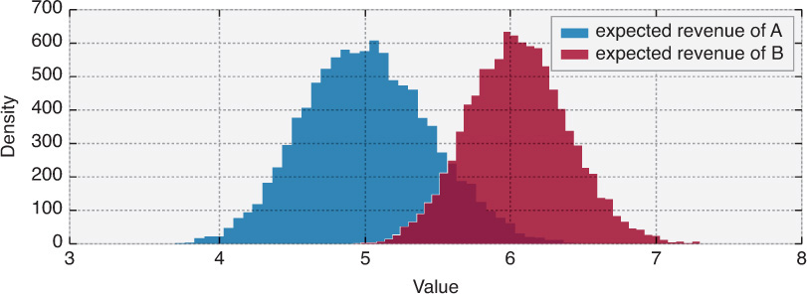
Extending to an A/B Experiment: The Results
p = (posterior_expected_revenue_B > posterior_expected_revenue_A).mean()
print("Probability that page B has a higher revenue than page A: %.3f" % p)
[Output]:
Probability that page B has a higher revenue than page A: 0.965

Slide 30
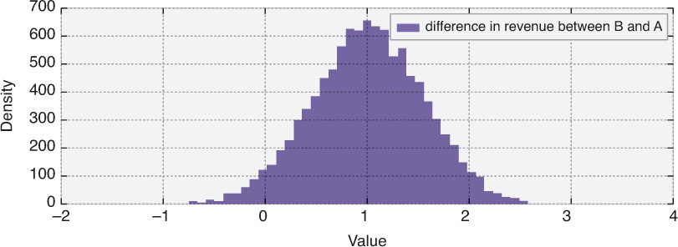
Posterior distribution of the delta between expected revenues of pages A and B
Looking at this posterior, we see that there is about a 50% chance that the difference is more than $1, and possibly even larger than $2. And if we are wrong about our choice of B (which is possible), we probably won’t lose much: The distribution doesn’t extend much past −$0.50.

Slide 31
Bayesian Estimation Supersedes the T-Test
BEST

Slide 32
Student’s T-Test
Probably the most taught statistical test in classrooms is the t-test. The traditional t-test is a frequentist test to determine whether there is a significant difference between the means of two groups
More generally, the t-test is any statistical hypothesis test in which the test statistic follows a Student's t-distribution under the null hypothesis.
Among the most frequently used t-tests are:
A one-sample location test of whether the mean of a population has a value specified in a null hypothesis.
A two-sample location test of the null hypothesis such that the means of two populations are equal.

Slide 33
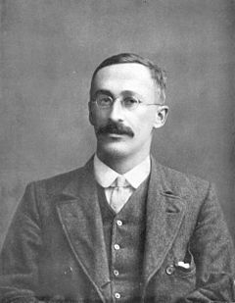

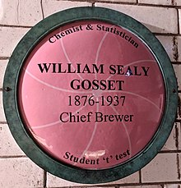
Some History
The t-statistic was introduced in 1908 by William Sealy Gosset, a chemist working for the Guinness brewery in Dublin, Ireland. "Student" was his pen name.
Gosset had been hired owing to Claude Guinness's policy of recruiting the best graduates from Oxford and Cambridge to apply biochemistry and statistics to Guinness's industrial processes. Gosset devised the t-test as an economical way to monitor the quality of stout. The t-test work was submitted to and accepted in the journal Biometrika and published in 1908. Company policy at Guinness forbade its chemists from publishing their findings, so Gosset published his statistical work under the pseudonym "Student“.
Guinness had a policy of allowing technical staff leave for study (so-called "study leave"), which Gosset used during the first two terms of the 1906–1907 academic year in Professor Karl Pearson's Biometric Laboratory at University College London. Gosset's identity was then known to fellow statisticians and to editor-in-chief Karl Pearson.

Slide 34
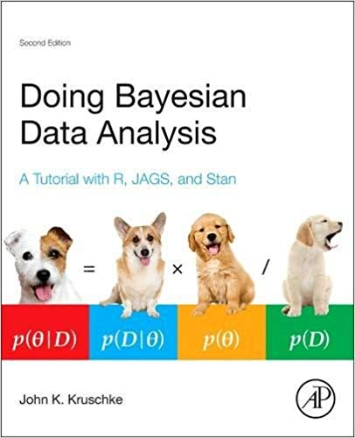
Bayesian Estimation Supersedes the T-Test
Kruschke, J. K. (2013). Bayesian estimation supersedes the t test. Journal of Experimental Psychology: General, 142(2), 573.

Slide 35

BEST
Bayesian estimation for two groups provides complete distributions of credible values for the effect size, group means and their difference, standard deviations and their difference, and the normality of the data. The method handles outliers. The decision rule can accept the null value (unlike traditional t tests) when certainty in the estimate is high (unlike Bayesian model comparison using Bayes factors).

Slide 36
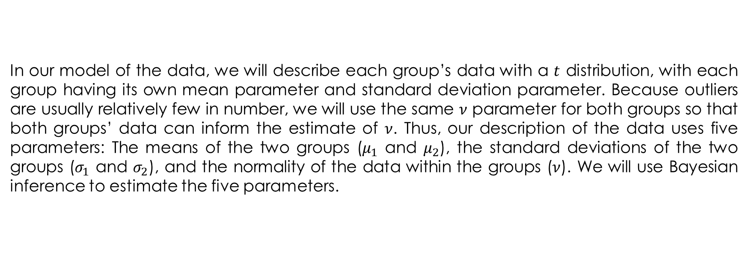
BEST
In our model of the data, we will describe each group’s data with a $t$ distribution, with each group having its own mean parameter and standard deviation parameter. Because outliers are usually relatively few in number, we will use the same $ν$ parameter for both groups so that both groups’ data can inform the estimate of $ν$. Thus, our description of the data uses five parameters: The means of the two groups ($μ_{1}$ and $μ_{2}$), the standard deviations of the two groups ($σ_{1}$ and $σ_{2}$), and the normality of the data within the groups ($ν$). We will use Bayesian inference to estimate the five parameters.

Slide 37
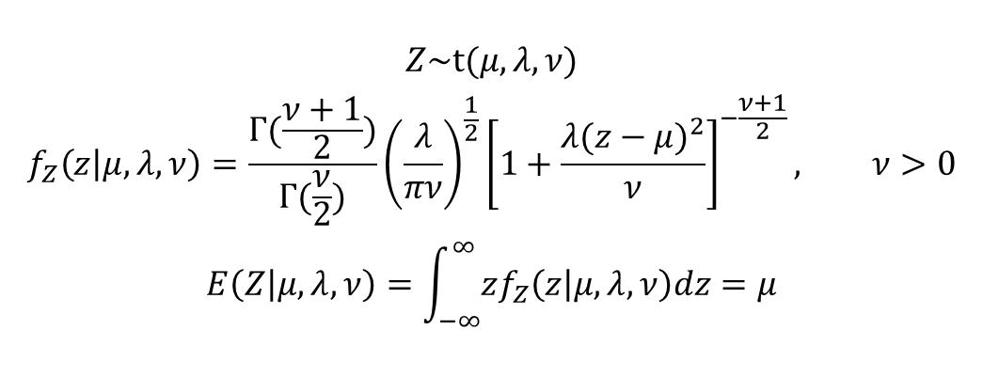
Student’s T-Distribution
$$Z\sim \text{t}(μ,λ, ν)$$
$$f_{Z}\left(z | μ,λ,ν\right)=\frac{Γ(\frac{ν+1}{2})}{Γ(\frac{ν}{2})}{\left(\frac{λ}{πν}\right)}^{\frac{1}{2}}{\left[1+\frac{λ{(z−μ)}^{2}}{ν}\right]}^{−\frac{ν+1}{2}}, ν>0$$
$$E\left(Z | μ,λ,ν\right)=\int_{−∞}^{∞}{zf_{Z}\left(z | μ,λ,ν\right)dz}=μ$$
Z=pymc.NoncentralT(“Z”, mu, lambda, nu)

Slide 38
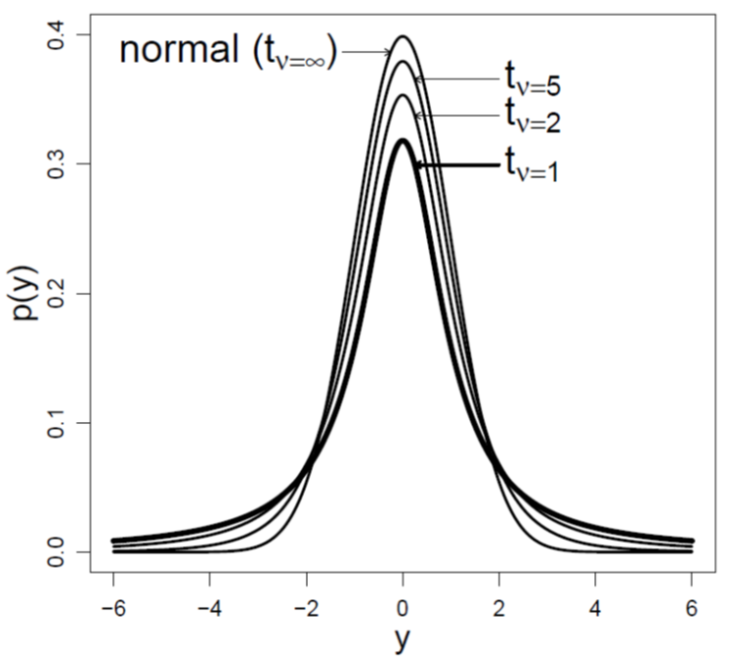
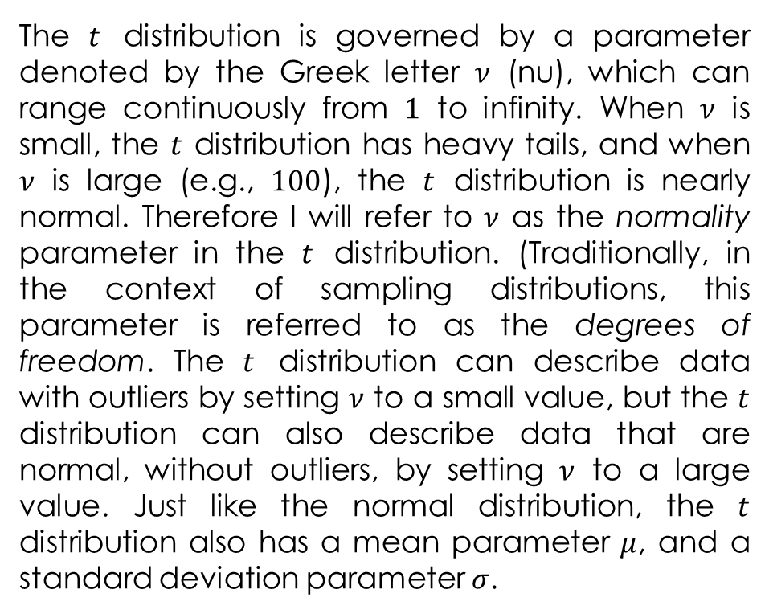
Student’s T-Distribution
The $t$ distribution is governed by a parameter denoted by the Greek letter $ν$ (nu), which can range continuously from $1$ to infinity. When $ν$ is small, the $t$ distribution has heavy tails, and when $ν$ is large (e.g., $100$), the $t$ distribution is nearly normal. Therefore I will refer to $ν$ as the normality parameter in the $t$ distribution. (Traditionally, in the context of sampling distributions, this parameter is referred to as the degrees of freedom. The $t$ distribution can describe data with outliers by setting $ν$ to a small value, but the $t$ distribution can also describe data that are normal, without outliers, by setting $ν$ to a large value. Just like the normal distribution, the $t$ distribution also has a mean parameter $μ$, and a standard deviation parameter $σ$.

Slide 39
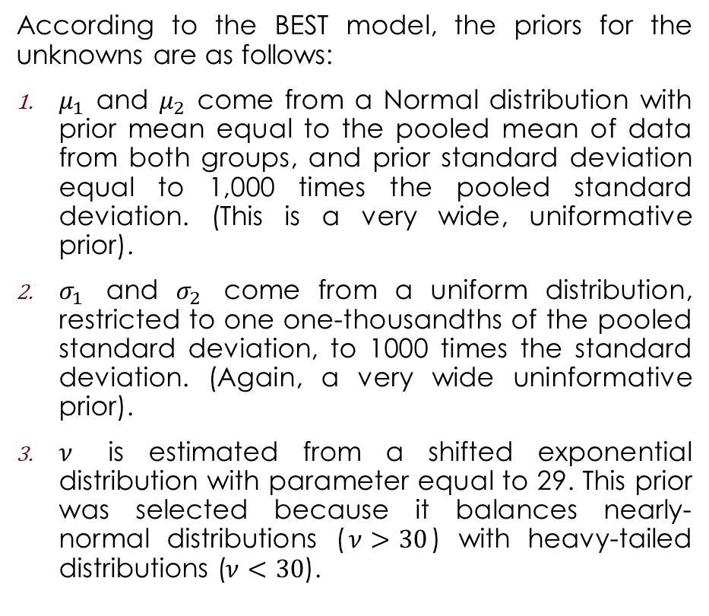
BEST
According to the BEST model, the priors for the unknowns are as follows:
$μ_{1}$ and $μ_{2}$ come from a Normal distribution with prior mean equal to the pooled mean of data from both groups, and prior standard deviation equal to 1,000 times the pooled standard deviation. (This is a very wide, uniformative prior).
$σ_{1}$ and $σ_{2}$ come from a uniform distribution, restricted to one one-thousandths of the pooled standard deviation, to 1000 times the standard deviation. (Again, a very wide uninformative prior).
$ν$ is estimated from a shifted exponential distribution with parameter equal to 29. This prior was selected because it balances nearly-normal distributions ($ν>30$) with heavy-tailed distributions ($ν<30$).

Slide 40
BEST in PyMC: The Setup
Following our A/B testing theme, suppose we have data about the length of time a user is on a test page. This data is not binary; it’s continuous. For example, we’ll create some artificial data with the following code:
N = 250
mu_A, std_A = 30, 4
mu_B, std_B = 26, 7
# create durations (seconds) users are on the pages for
durations_A = np.random.normal(mu_A, std_A, size = N)
durations_B = np.random.normal(mu_B, std_B, size = N)

Slide 41
BEST in PyMC: The Model
pooled_mean = np.r_[durations_A, durations_B].mean()
pooled_std = np.r_[durations_A, durations_B].std()
tau = 1. / np.sqrt(1000. * pooled_std) # PyMC uses a precision # parameter, 1/sigma**2
mu_A = pm.Normal("mu_A", pooled_mean, tau)
mu_B = pm.Normal("mu_B", pooled_mean, tau)
std_A = pm.Uniform("std_A", pooled_std / 1000., 1000. * pooled_std)
std_B = pm.Uniform("std_B", pooled_std / 1000., 1000. * pooled_std)
nu_minus_1 = pm.Exponential("nu-1", 1./29)
obs_A = pm.NoncentralT("obs_A", mu_A, 1.0 / std_A ** 2, nu_minus_1 + 1,
observed = True, value = durations_A)
obs_B = pm.NoncentralT("obs_B", mu_B, 1.0 / std_B ** 2, nu_minus_1 + 1,
observed = True, value = durations_B)
mcmc = pm.MCMC([obs_A, obs_B, mu_A, mu_B, std_A, std_B, nu_minus_1])
mcmc.sample(25000,10000)

Slide 42
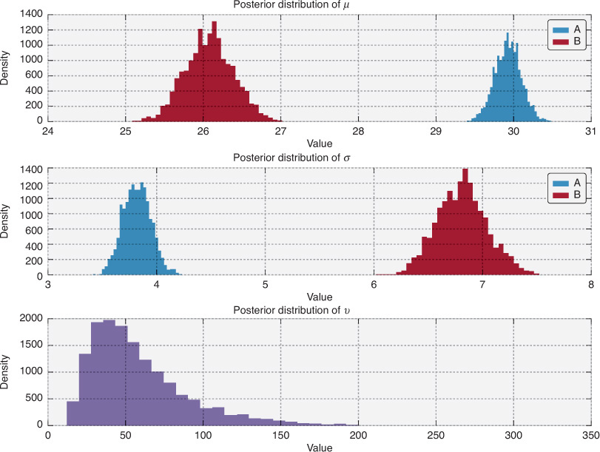
The Results
We can see that not only does page A have a higher average duration of time spent on the page, but the volatility of each page view is lower (as page A’s standard deviation is lower). Furthermore, with these posteriors, we can calculate differences between groups, effect sizes, and so on.

